Slide 1
IO Lab
Spring 2016
Module 1- Lec 1 - Introduction
Jan 20 2016

Slide 2
Today
Course Goals
Course Structure
Logistics
IOLab 2016 Immersion
Questions

Slide 3
Instructors
Bob Glushko (Professor - UC Berkeley School of Information)
Aditya Mishra (2nd Year MIMS)
Strategy, TechConsulting+GMAT instructor , Games
Alexander Jones (2nd Year MIMS)
Product Management, B2B Enterprise SaaS, IoT TA Sp15
Vijay Velagapudi (2nd Year MIMS)
Analytics and Data Engineering, INFO 202 TA

Slide 4
Course Goals
What is IO Lab?

Slide 5
Background
Previously offered in Fall 2014, Fall 2013, Fall 2012
Hands-on approach to implementing 202 concepts
Building information systems : web and overview of mobile
Not just code - but architect[202]
Notes:
IOLab started in 2012 and this is the fourth time IOLab is being offered.

Slide 6
Our Objective
To help you design and develop information systems
Applying principles from Info 202: Information Organization and Retrieval
By leveraging current web technologies and tools
Our focus is on how you can implement these principles in your application, not teaching the principles themselves

Slide 7
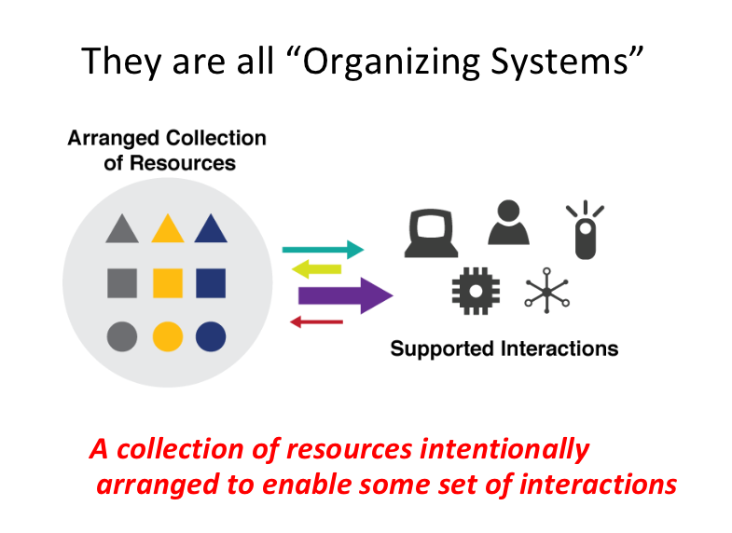

Slide 8
202 Concepts | Delivered through Module | Topic
Architectural Thinking | Front End | HTML/CSS/Javascript
Architectural Thinking | Front End | Systems Architecture Planning
Relationships, Taxonomies and Ontologies, Scope and Scale | Back End | Modelling Relational DBs
Granularity and Abstraction | Back End | Modelling Document-Based DBs
Institutional classification | Advanced topics | Using APIs
Controlled Vocab, Scope and Scale | Advanced topics | API Design
Document Type Spectrum | Advanced topics | Web Scraping
Info 202 principles in practice
Notes:
You’ll make a number of decisions when you design your application
speed, interface aesthetics,
Abstraction allows developers to concentrate on the essential, relevant or important parts of an application. It uses a mapping to a model from things in reality or from virtual things.
Developers typically use conceptual models or languages for representing and conceptualising abstractions. The enhanced entity-relationship model schema are typically depicted by an EER diagram..

Slide 9
What you’ll be doing
Learning fundamentals of web development through 4 course modules
Implementing information architecture principles - best practices for designing systems
Hands-on sessions to apply Info 202 principles
Reading material and reading responses
You’ll build an application !! (Final group projects)
Notes:
complete beginners to the subject, and assumes you have no knowledge of creating web apps. But we do assume that you remember principles from 202, and we w

Slide 10
Learning principles
Not about talking/demos - more about practice
Not just read, dive in!
Design, plan before you code
Walk, run, and fall. Repeat
Deliberate Practice : pair feedback
Notes:
this is not a lecture series, we’ll give you concepts and theory and help you impl,ement them
the more you practice, the more you fail, the better you will get
having said that, introduce deliberate practice
Terminology: frameworks, protocols, design patterns etc..

Slide 11
Logistics
Course Websites
BCourses: Assignments, Grades, Reading material, Syllabus
Github: Code, Resources, Templates etc
Grading policies
40% final project deliverable
40% weekly submissions (assignments + project milestones + reading responses)
20% participation (attendance and class work)

Slide 12
Logistics
Final project
Functional system - not a prototype
Mobile or Web App or hybrid with working and deployed components
Team size 2-4 People
Periodic milestones and then final deliverable
Ideas - choose ours or pitch your own
Find an interesting topic and cool people to work with :)
Presentation details - coming soon!

Slide 13
Course Structure

Slide 14
Course Structure
Module 1 : Getting Started
Fundamentals, Git, IDEs, Command line etc
Module 2 : Front End design and development
HTML, CSS, DOM, JavaScript, JQuery, Ajax
Module 3 : Back End design and development
Web Frameworks, architecture , Database design
Module 4 : Advanced tools
APIs, Visualization tools, Security, Deployment
Project Presentations

Slide 15




Map
Getting Started
Front End
Back End
Advanced Topics
Introduction
Fundamentals
Git
Command Line
HTML
CSS
Responsive Design
JavaScript & jQuery
Web Frameworks
Architecture
Database Design
APIs
Visualization
Security
Deployment
Notes:
This is the course map for IOLab 2016
We have packaged the course in four modules

Slide 16
Immersion
Connecting everything together
IOLab 2016

Slide 17
Immersion
What is a front-end & back-end?
What are different technologies that support them?
How do they work together in the application architecture?
Know your tech
HTML , CSS
JavaScript Vs jQuery
Frameworks
Databases
Notes:
we wanted to spend some time diving into app development. the idea was many systems development classes start with HTML or CSS but students do not have an overview of the whole picture.
After six months, there were still people who did not understand the difference between Java and JavaScript.
Today we will touch upon different parts of this process - (Read through slide)

Slide 18

Class exercise
Split into groups of 4-6
Draw how you think LinkedIn is architected (client-server model)
Detail one specific user interaction ( endorsements or connection requests)
Highlight INFO 202 principle(s) you see in the model

Slide 19
Refresher - how the web works
Traditionally a 2-tiered approach
Client-Server
Client sends request, server processes and responds
Multi-tiered paradigm
Encapsulation of application services
Scalability
Examples - web server, load balancers, services (message queues, file servers)
Mobile apps enablement
API Layer on top of web apps
Notes:
There are hundreds of ways to configure a Web application. That said, most of them follow the same basic structure: a client, a server, and a database.
A server process, running on a server host, provides access to a service.
A client process, running on a client host, accesses the service via the server process.
Three-Tier Architecture
A front-end tier web server for static content, caching, and UI generation.
A middle tier application logic server for encapsulating application services.
A back-end tier database server for storage, indexing, and querying data.

Slide 20
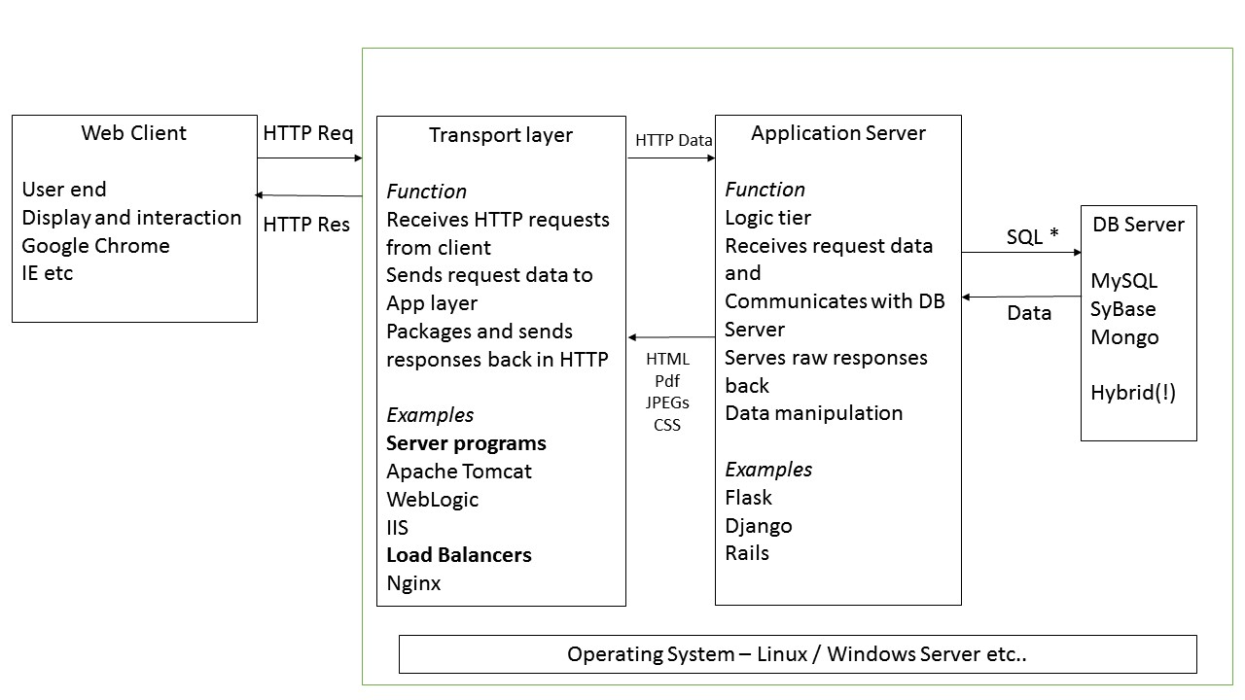

Slide 21
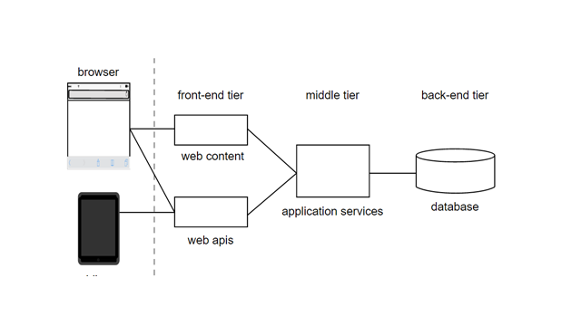
Multi-tiered approach for mobile
Notes:
Architectural thinking : database layer - where your info is stored, versus application layer where logic is processed.
separation of concerns - abstracting as much as possible so your code is modular and you are not duplicating

Slide 22

Front-End
What you see, touch, or interact with
Less about code, more about the experience
Built on Empathy, Abstraction, Simplicity
Governs usability

Slide 23
Front-End cont’d..
All about rendering
Convert written code to visual styles, layouts, and controls
Different platforms: different technologies
Mobile
Native: Android, IoS, HTML5
Browsers
Web
HTML, complemented by CSS & JavaScript
Desktop
Dot Net, C++, Visual Basic

Slide 24
Front-ends in web applications
‘View’ of the internet
Presentation layer
All about HTML
Hypertext markup language
The only thing that the user sees
<html>
<head>
<title>Hello World !<\title>
<\head>
<body>
Hello World !
<\body>
<\html>
Notes:
no matter what you build how much long , clutter etc, in the end its just html that the end user sees
you could augment it, make it look better, jazz it up, animate it, make it dynamic, but its just manipulation

Slide 25
Front-end in web applications contd..
CSS - cascading style sheets
CSS gives you control over how your site looks
Can be inline or external
Bootstrap is a popular CSS framework
Helps websites become Responsive
Notes:
w3c standard
most HTML4 elements and attributes that are no longer available in HTML5 happen to be presentational. The word you will find online to indicate that something is no longer used is deprecated.

Slide 26
Front-end in web applications contd..
Scripts!
Static vs Dynamic content
JavaScript
Traditionally Client-side
Recently Server-side
Combines with CSS
jQuery and Ajax
Interact with back-end
New info same page
<head>
<script type = “text/javascript”>
alert(“Hello World!”);
</script>
</head>
Notes:
The origin of the term was similar to its meaning in "a movie script tells actors what to do": a scripting language controlled the operation of a normally-interactive program, giving it a sequence of work to do all in one batch. For instance, one could put a series of editing commands in a file, and tell an editor to run that "script" as if those commands had been typed interactively.
http://c2.com/cgi/wiki?ScriptingLanguageS
cripting languages are programming languages that don't require an explicit compilation step.
For example, in the normal case, you have to compile a C program before you can run it. But in the normal case, you don't have to compile a JavaScript program before you run it. So JavaScript is sometimes called a "scripting" language.
JavaScript is most commonly used as a client side scripting language. This means that JavaScript code is written into an HTML page. When a user requests an HTML page with JavaScript in it, the script is sent to the browser and it's up to the browser to do something with it.

Slide 27

Back-End
Enables the front-end
Software
Business logic, calculations, Information architecture
Hardware
Servers, Databases and infrastructure
Stability, Security, Performance, and Scalability

Slide 28
Back-end contd..
Design choices based on product
Functional
Technical
Political
Technical choices
Language
Framework
Database : SQL / NoSQL, etc.
Architecture

Slide 29
Step #1 - Language
Tons of options
Python, Java, PHP, Ruby (Personal favorite)
JavaScript gaining popularity
Similar principles ; different syntax
Language choices
Support( Tools, Libraries), Platform, Problem domain
Most importantly - your comfort level
Go deep, not broad
Instagram (Python), LinkedIn (Java), Twitter (Ruby)
Change - foundational versus scaling up
Notes:
PHP is an open source language and fast prototyping language. embeds in html
Python is really popular readability and simplicity : Pinterest, Instagram etc
Java- robust, secure
Javascript - one language, both sides

Slide 30
Step #2 - Frameworks
Web apps have similar underlying tasks
Dealing with different requests
Choosing pages to display + what content
Frameworks help abstract these tasks
Each language has popular frameworks
Python : Flask, Django
Ruby : Rails
Build your own..
Simple [build from scratch] vs Complex [All-inclusive]
More in Module 3
Notes:
https://wakatime.com/django-vs-flask-worksheet
first time i programmed with spring/struts no idea what a framework was
think about the whole request response mechanism
Hybrid of flask and django; flask is really good at serving json
https://www.jeffknupp.com/blog/2014/03/03/what-is-a-web-framework/
Have a few hours? Grab a coffee and read the Flask source code. It's micro so you can actually read the whole source in one sitting.

Slide 31
Step #3 - Data & Infrastructure
Information persistence
Server Side: Database, Text Files, Spreadsheets
Client Side: Local storage via HTML 5
Databases
SQL RDBMS: Structured; NoSQL: Unstructured
Cloud Storage via API
Firebase. Google Docs
Module 3
Designing a relational DB, NoSQL - MongoDB etc..

Slide 32
Step #4 - Add Magic
API Layer
Interact with other services, set up your own
Deploy your stuff
Domain name, Server space, hosting etc.
Security and Scaling
Common attacks and how to secure your app
Load balancing, etc...
Module 4
Advanced tools will help you run with your app

Slide 33
Summary
Module 1 & 2 : Intro/Front-End
HTML, CSS , best practices for good design
JavaScript breathes life
jQuery simplifies in-page interactions
Module 3 : Back-End
Choose a language you’re comfortable with: Python
A web-framework that allows you to build up rapidly: Flask
Give you a flavour of other frameworks: Meteor, Django
Databases!
Module 4 :
Deployment and other tools

Slide 34
Quick Poll
Linux
Windows
Mac

